Slide 1



t
Slide
1
BLOCKCHAIN-BASED LOTTERY SYSTEM
Secure , Transparent , Decentralized Lottery Platform
BY :
PRABHAT MAURYA
ROLL NO: 2308020100060
TECH STACK: Solidity | Django | Web3.js | Sqlite | Bootstrap | Sepoliya Tesnet | Metamask Wallet

Slide 2



PROBLEM STATEMENT
Slide
2
Traditional lottery systems suffer from a lack of transparency, trust, and automation. Participants have no guarantee that the process is fair or that the winner selection isn’t manipulated. There is a strong need for a decentralized and tamper-proof solution to ensure fairness, transparency, and trust among all participants.
Traditional lottery systems are centrally controlled, making them prone to fraud or manipulation.
Lack of transparency — participants can’t verify how winners are selected.
No public proof that funds are distributed correctly.
Manual processes cause delays and human errors.
Data tampering is possible in centralized servers.
Participants must trust the organizer blindly, without blockchain-level verification.
Next

Slide 3


PROPOSED SOLUTION
Slide
3
A Blockchain-powered decentralized lottery system.
Lottery creation and participation through smart contracts.
Manager controls the lottery but can’t manipulate the result.
Automatic winner transfer directly to the winner’s wallet.
Completely transparent and verifiable on the blockchain.
Next

Slide 4
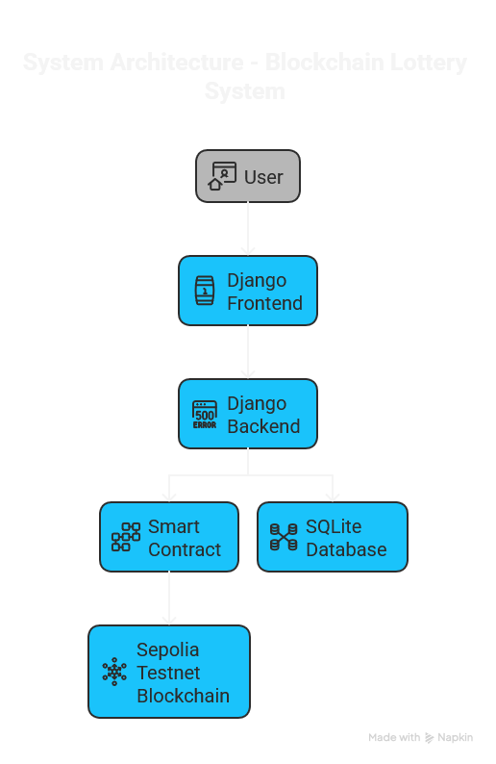

Slide
4
SYSTEM ARCHITECTURE
Next

Slide 5

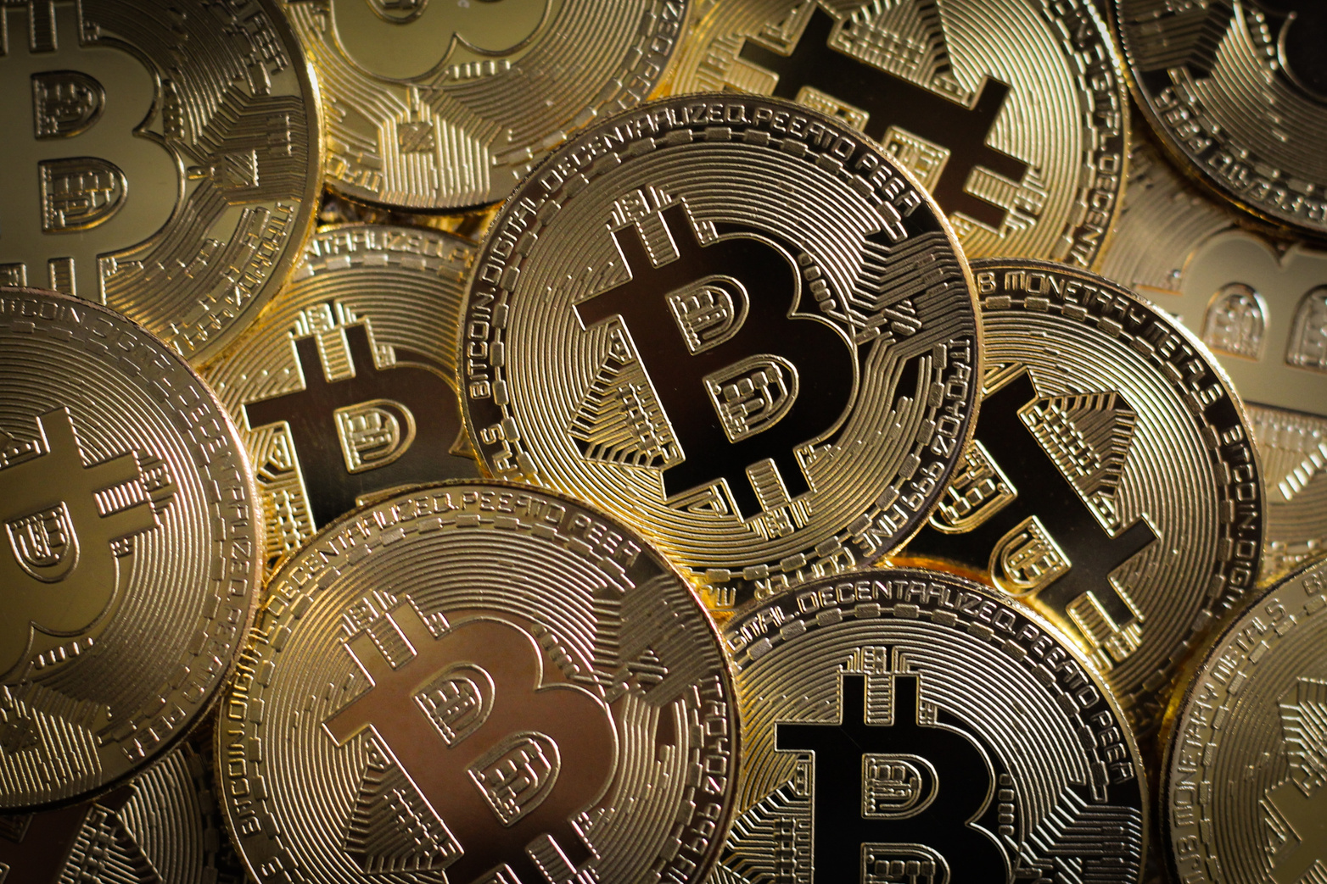

Slide
9
SMART CONTRACT FEATURES ( SOLIDITY )
createLottery() → Manager creates new lottery.
participate() → Users can buy lottery tickets.
getBalance() → Manager can view total pool amount.
selectWinner() → Random winner is chosen securely.
receive() → Accepts ETH from participants.
transfer() → Winner automatically receives reward.
Next

Slide 6
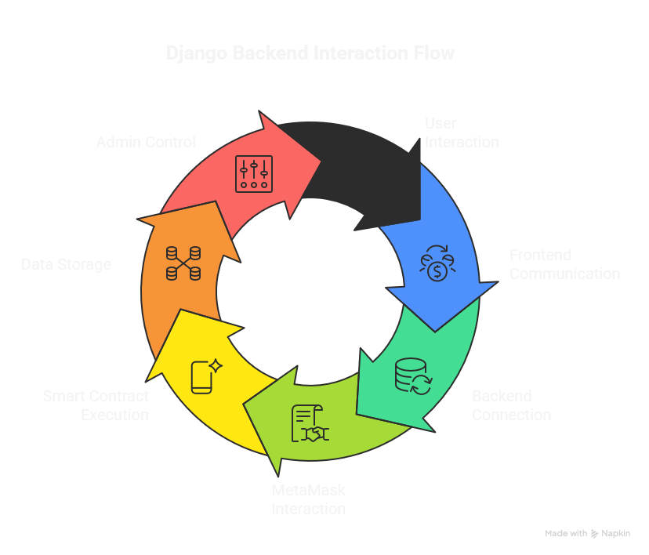

Slide
6
BACKEND (DJANGO)
Next

Slide 7
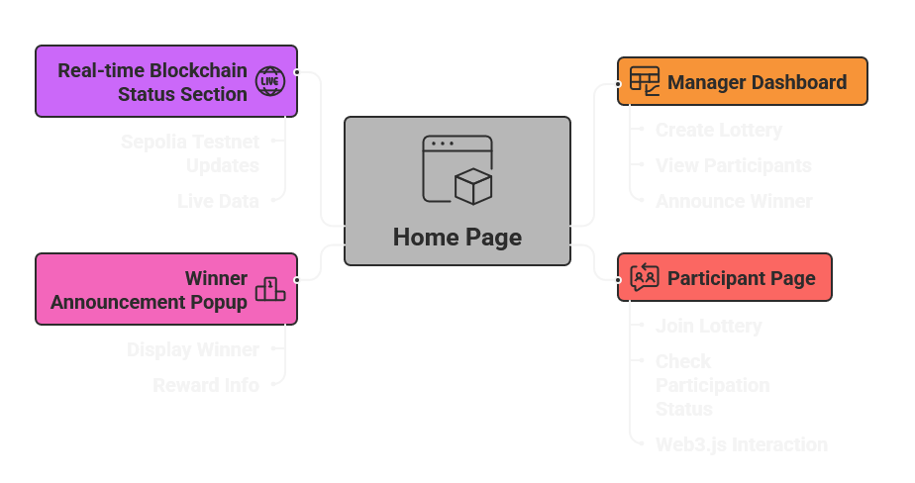
Slide
8
USER INTERFACE
Simple and responsive design using Bootstrap.
Next

Slide 8

Slide
6
SECURITY & TRANSPARENCY
Blockchain ensures immutability and public verification.
Random winner selection is verifiable via smart contract logic.
No third-party involvement.
Funds are locked in the contract until winner selection.
Next

Slide 9
FUTURE SCOPE
Slide
9
NFT-based lottery tickets.
Multi-lottery system.
Integration with Polygon mainnet.
AI-based fraud detection.
RESULT
Successfully deployed on Sepolia Testnet.
Demonstrated fair lottery execution and ETH transfer.
Next

Slide 10

Slide
10
t
LIVE DEMONSTRATION
Blockchain-Based Lottery System
Back

